Slide 1
Autonomous movement framework
Arianit Pajaziti
Rinor Bytyci

Slide 2
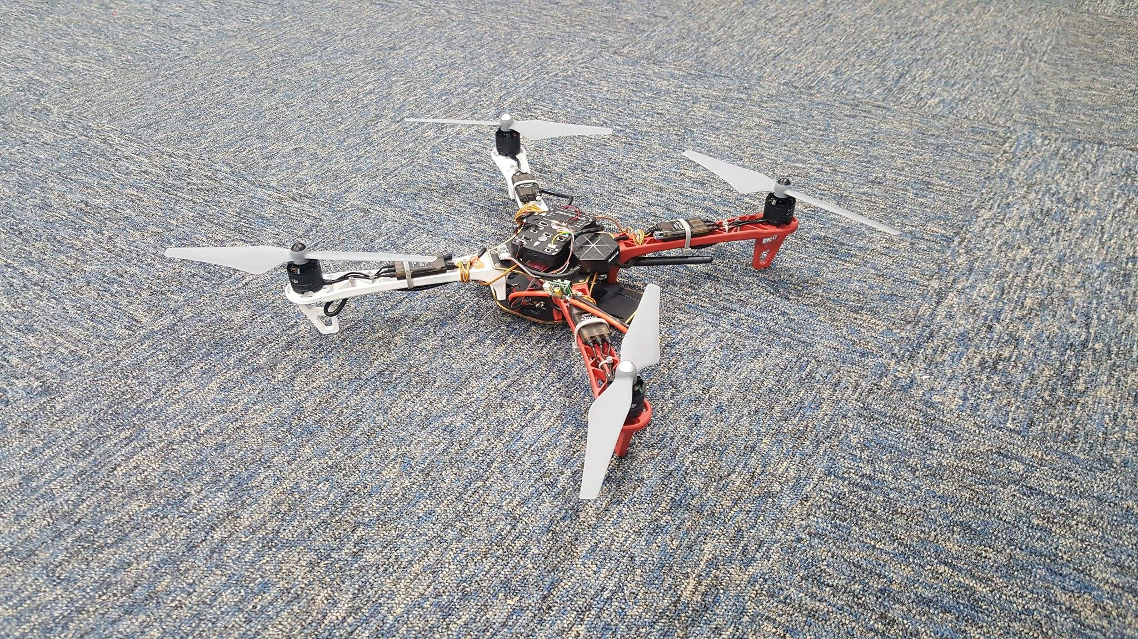
Autonomous movement framework
What is AMF?
The Autonomous Movement Framework is a hardware and software system that lets unmanned aerial vehicles (UAVs) fly and navigate autonomously.
The PixHawk controller, GPS, and transmitter aboard the drone automatically calculate a flight plan after a destination is given.

Slide 3
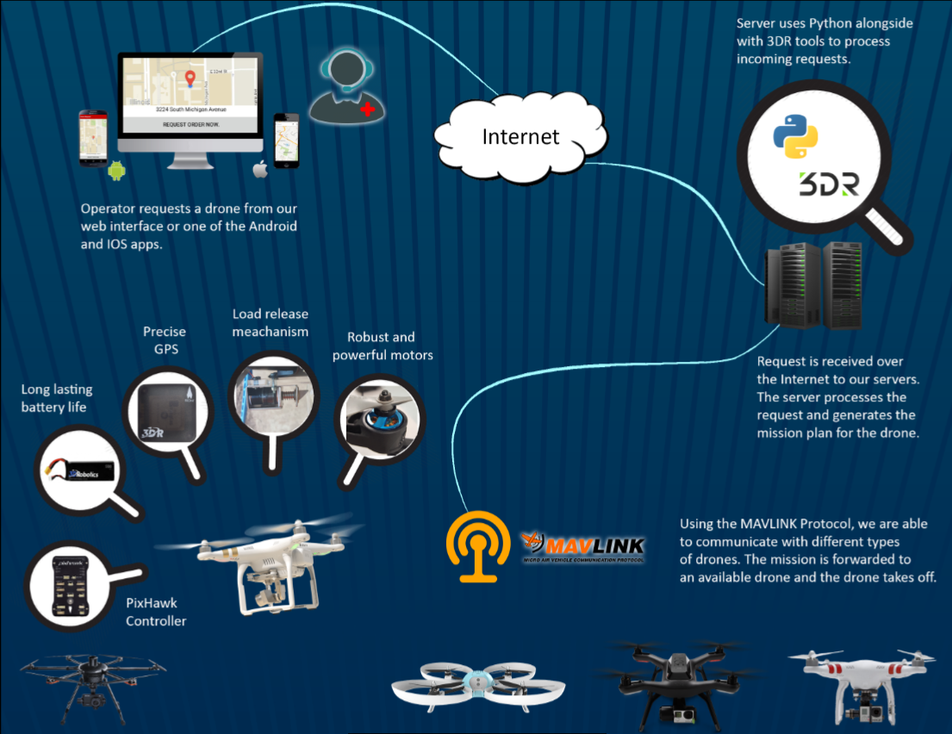
Functional prototype

Slide 4
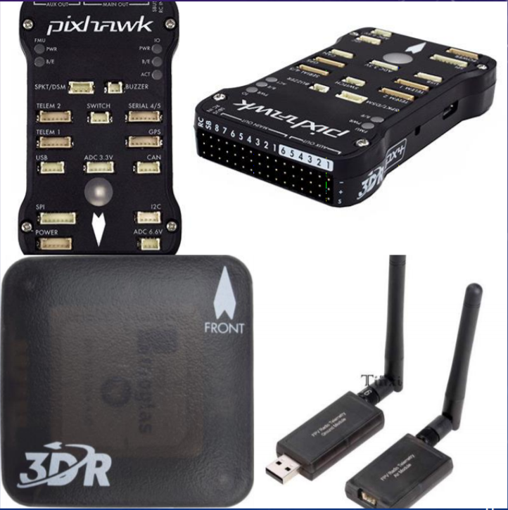
Hardware components
3DR IRIS+ quadcopter drone
• PixHawk controller
• GPS antenna
• 3DR antennas
• Prototype
• Custom solenoid-activated cargo hook, 1-2kg capacity

Slide 5

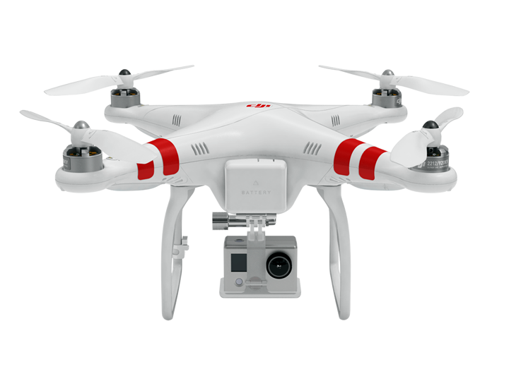
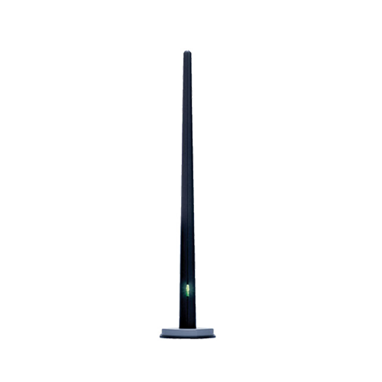
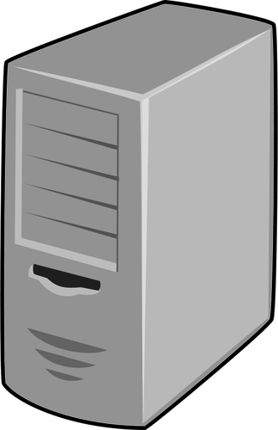
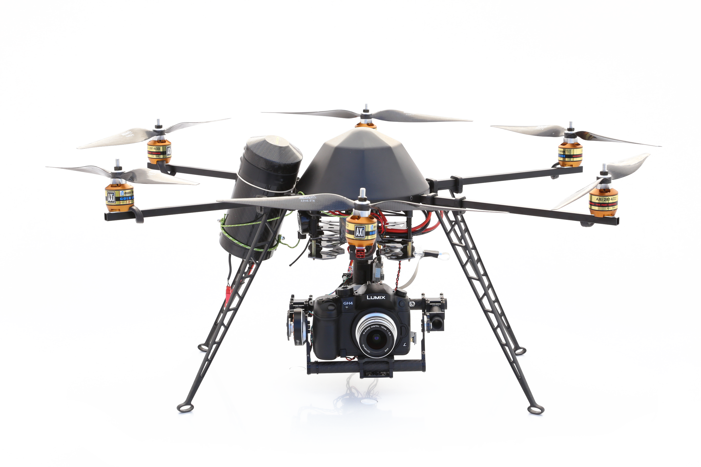

Problem
Server
Mission upload...

Slide 6

Solution
Server
Mission upload...

Slide 7
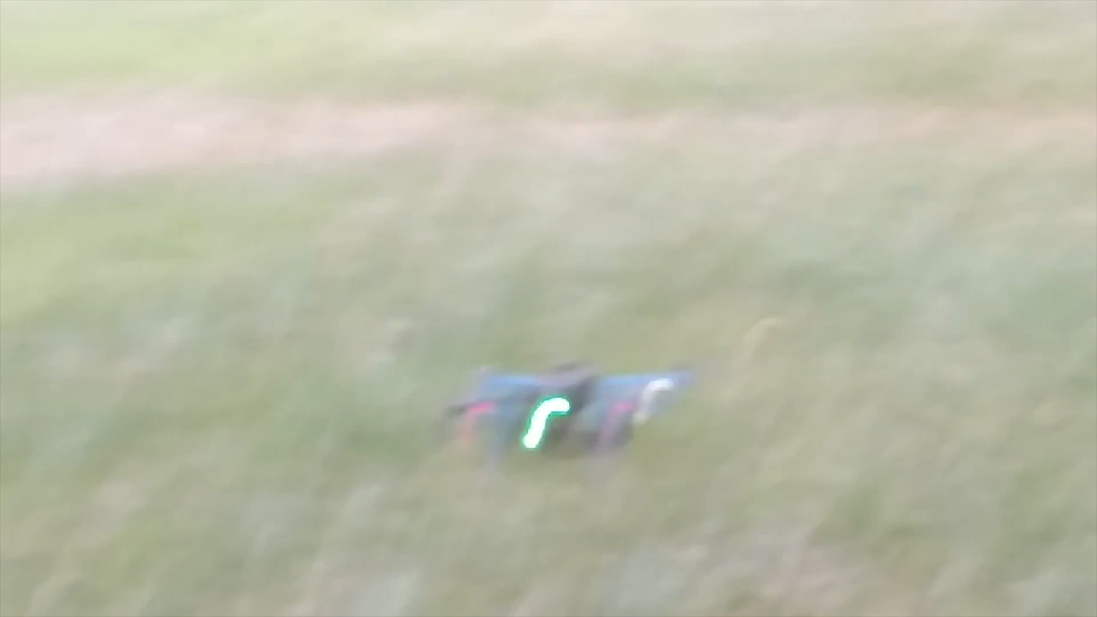
Demo
Initial attempts

Slide 8
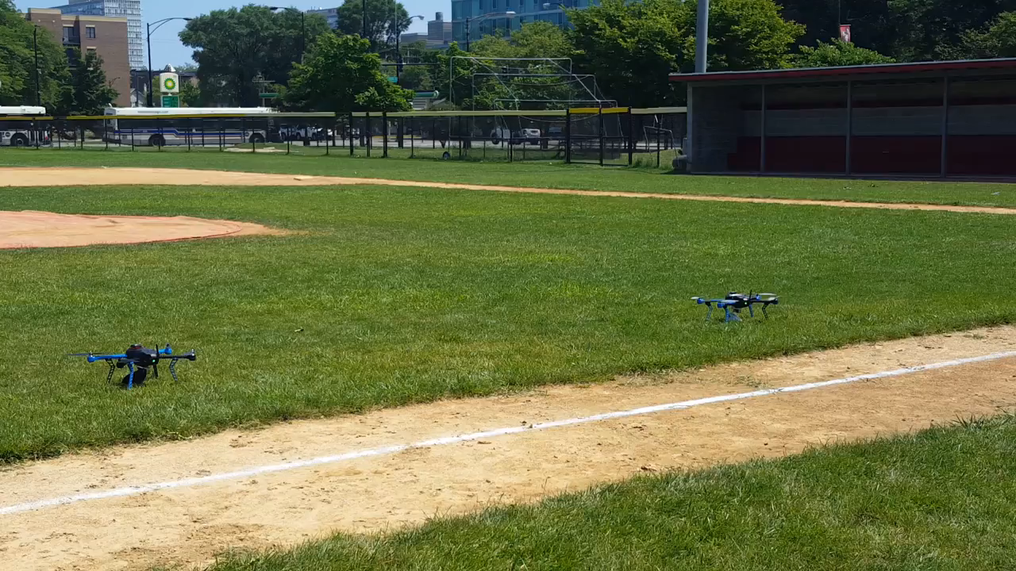
Demo
Final results

Slide 9
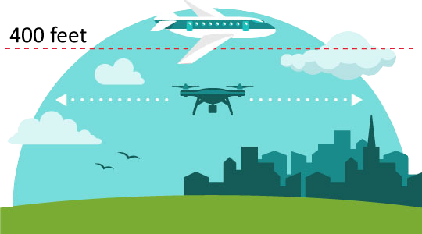
Autonomous movement framework
Consumer delivery drone challenges:
• Safety/security/privacy—Drones may crash, be hacked and be intrusive
Current use cases:
• AMF commercializes drones by providing a autonomous navigation system that can be adapted to diverse aircraft/missions
• AMF is aimed at disaster relief, utilizing its flexibility and adaptability while resolving issues of safety, security and privacy

Slide 10
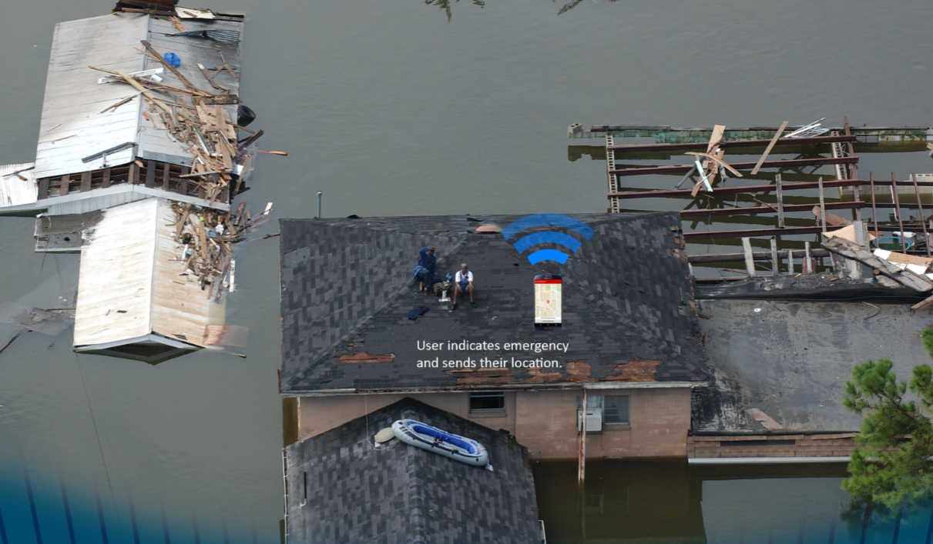
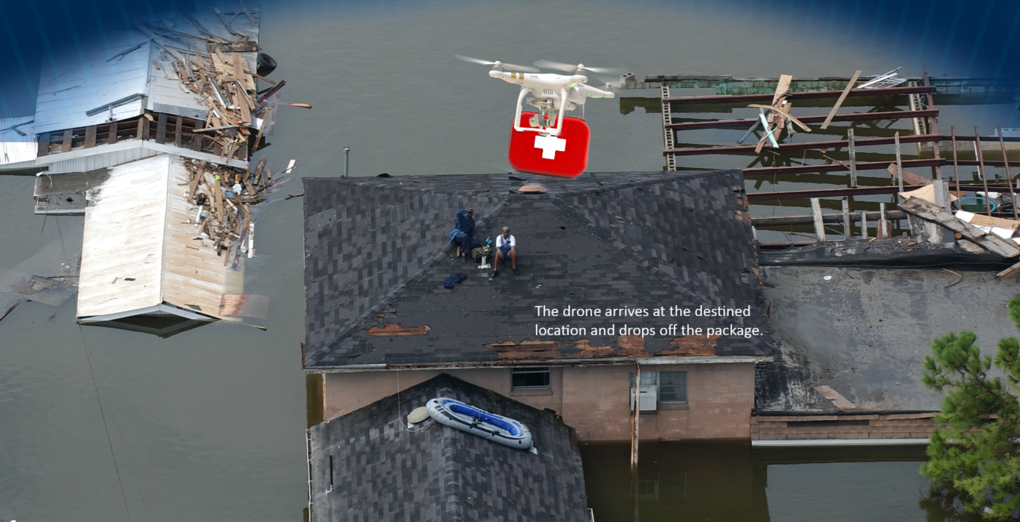
Use case

Slide 11
Costs and commercial viability: Options
Selling drones complete with AMF framework
• Selling licenses to use and customize the AMF framework
• Providing maintenance and support for the AMF system

Slide 12
Conclusion
The Autonomous Movement Framework project seeks to commercialize unmanned aerial vehicles not by standardizing aircraft, but by offering a flexible, autonomous navigation system.
Slight hardware modifications on the drone, coupled with the server, web interface, operators, and user apps allow easy drone mobilization that can be adapted to many uses.
Disaster relief is the initial application because it overcomes many current obstacles, but the AMF itself is not limited to a single mission or aircraft

Slide 13
Questions?

